Slide 1

GLOBAL FLOATING PRODUCTION STORAGE AND OFFLOADING (FPSO) MARKET
Market Size, Share and Forecast; Market Outlook, Opportunity and Data Analysis 2023-2030

Slide 2
TABLE OF CONTENTS
Section 1
Global Floating Production Storage and Offloading (FPSO) Market Methodology and Scope
Research methodology
Scope of the Report
Section 2
Global Floating Production Storage and Offloading (FPSO) Market Definition and Overview
Section 3
Global Floating Production Storage and Offloading (FPSO) Market – Executive Summary
Market Snippet by Type
Market Snippet by Carrier Type
Market Snippet by Depth
Market Snippet by Hull Type
Market Snippet by Region
Primary Analysis
Secondary Analysis
DataM Intelligence Analysis

Slide 3
TABLE OF CONTENTS
Section 4
Global Floating Production Storage and Offloading (FPSO) Market – Market Dynamics
Market Impacting Factors
Drivers
Rise in offshore activities in deep water areas
Flexibility of the system
Restraints
Severe budget constraints and limited FPSO service to the current production platforms
Opportunity
XX
Impact Analysis

Slide 4
TABLE OF CONTENTS
Section 5
Global Floating Production Storage and Offloading (FPSO) Market – Industry Factors
Porter’s Five Force Analysis
Regulatory Analysis
Supply Chain Analysis
Pricing Analysis

Slide 5
TABLE OF CONTENTS
Section 6
Global Floating Production Storage and Offloading (FPSO) Market – By COVID-19 Analysis
Analysis of COVID-19 on the Market*
Before COVID-19 Market Scenario
Present COVID-19 Market Scenario
After COVID-19 or Future Scenario
Pricing Dynamics Amid COVID-19
Demand-Supply Spectrum
Government Initiatives Related to the Market During Pandemic
Manufacturers Strategic Initiatives
Conclusion

Slide 6
TABLE OF CONTENTS
Section 7
Global Floating Production Storage and Offloading (FPSO) Market – By Type
Introduction
Market Size Analysis and Y-o-Y Growth Analysis (%), By Type
Market Attractiveness Index, By Type
Oil*
Introduction
Market Size Analysis, US$ Million, 2021-2030 and Y-o-Y Growth Analysis (%), 2022-2030
LPG
LNG
Others

Slide 7
TABLE OF CONTENTS
Section 8
Global Floating Production Storage and Offloading (FPSO) Market – By Carrier Type
Introduction
Market Size Analysis and Y-o-Y Growth Analysis (%), By Carrier Type
Market Attractiveness Index, By Carrier Type
Converted Ship*
Introduction
Market Size Analysis, US$ Million, 2021-2030 and Y-o-Y Growth Analysis (%), 2022-2030
New Build Ship
Redeployed
Asphalt
Ceramic
Metals

Slide 8
TABLE OF CONTENTS
Section 9
Global Floating Production Storage and Offloading (FPSO) Market – By Depth
Introduction
Market Size Analysis and Y-o-Y Growth Analysis (%), By Depth
Market Attractiveness Index, By Depth
Shallow Water*
Introduction
Market Size Analysis, US$ Million, 2021-2030 and Y-o-Y Growth Analysis (%), 2022-2030
Deep & Ultra-deep Water

Slide 9
TABLE OF CONTENTS
Section 10
Global Floating Production Storage and Offloading (FPSO) Market – By Hull Type
Introduction
Market Size Analysis and Y-o-Y Growth Analysis (%), By Hull Type
Market Attractiveness Index, By Hull Type
Single Hull*
Introduction
Market Size Analysis, US$ Million, 2021-2030 and Y-o-Y Growth Analysis (%), 2022-2030
Double Hull

Slide 10
TABLE OF CONTENTS
Section 11
Global Floating Production Storage and Offloading (FPSO) Market – By Region
Introduction
Market Size Analysis and Y-o-Y Growth Analysis (%), By Region
Market Attractiveness Index, By Region
North America
Introduction
Key Region-Specific Dynamics
Market Size Analysis and Y-o-Y Growth Analysis (%), By Type
Market Size Analysis and Y-o-Y Growth Analysis (%), By Carrier Type
Market Size Analysis and Y-o-Y Growth Analysis (%), By Depth
Market Size Analysis and Y-o-Y Growth Analysis (%), By Hull Type
Market Size Analysis and Y-o-Y Growth Analysis (%), By Country
U.S.
Canada
Mexico

Slide 11
TABLE OF CONTENTS
Section 11
Global Floating Production Storage and Offloading (FPSO) Market – By Region
South America
Introduction
Key Region-Specific Dynamics
Market Size Analysis and Y-o-Y Growth Analysis (%), By Type
Market Size Analysis and Y-o-Y Growth Analysis (%), By Carrier Type
Market Size Analysis and Y-o-Y Growth Analysis (%), By Depth
Market Size Analysis and Y-o-Y Growth Analysis (%), By Hull Type
Market Size Analysis and Y-o-Y Growth Analysis (%), By Country
Brazil
Argentina
Rest of South America

Slide 12
TABLE OF CONTENTS
Section 11
Global Floating Production Storage and Offloading (FPSO) Market – By Region
Europe
Introduction
Key Region-Specific Dynamics
Market Size Analysis and Y-o-Y Growth Analysis (%), By Type
Market Size Analysis and Y-o-Y Growth Analysis (%), By Carrier Type
Market Size Analysis and Y-o-Y Growth Analysis (%), By Depth
Market Size Analysis and Y-o-Y Growth Analysis (%), By Hull Type
Market Size Analysis and Y-o-Y Growth Analysis (%), By Country
Germany
UK
France
Spain
Italy
Rest of Europe

Slide 13
TABLE OF CONTENTS
Section 11
Global Floating Production Storage and Offloading (FPSO) Market – By Region
Asia-Pacific
Introduction
Key Region-Specific Dynamics
Market Size Analysis and Y-o-Y Growth Analysis (%), By Type
Market Size Analysis and Y-o-Y Growth Analysis (%), By Carrier Type
Market Size Analysis and Y-o-Y Growth Analysis (%), By Depth
Market Size Analysis and Y-o-Y Growth Analysis (%), By Hull Type
Market Size Analysis and Y-o-Y Growth Analysis (%), By Country
China
India
Japan
Australia
Rest of Asia-Pacific

Slide 14
TABLE OF CONTENTS
Section 11
Global Floating Production Storage and Offloading (FPSO) Market – By Region
Middle East & Africa
Introduction
Key Region-Specific Dynamics
Market Size Analysis and Y-o-Y Growth Analysis (%), By Type
Market Size Analysis and Y-o-Y Growth Analysis (%), By Carrier Type
Market Size Analysis and Y-o-Y Growth Analysis (%), By Depth
Market Size Analysis and Y-o-Y Growth Analysis (%), By Hull Type

Slide 15
TABLE OF CONTENTS
Section 12
Global Floating Production Storage and Offloading (FPSO) Market – Competitive Landscape
Competitive Scenario
Market Positioning/Share Analysis
Mergers and Acquisitions Analysis
Section 13
Global Floating Production Storage and Offloading (FPSO) Market – Company Profiles
BP Plc *
Company Overview
Product Portfolio and Description
Key Highlights
Financial Overview
Aker Solutions ASA
Bluewater Energy Services B.V.
Bumi Armada Berhad
BW Offshore

Slide 16
TABLE OF CONTENTS
Section 13
Global Floating Production Storage and Offloading (FPSO) Market – Company Profiles
Chevron Corporation.
ExxonMobil
MODEC
Petrobras
Petronas
SBM Offshore
Shell Plc
Teekay Corporation
Yinson Holdings Berhad
LIST NOT EXHAUSTIVE

Slide 17
TABLE OF CONTENTS
Section 14
Global Floating Production Storage and Offloading (FPSO) Market – DataM
Appendix
About Us and Services
Contact Us
Note:
“*” indicates the similar breakdown for rest of the segmentation in the scope

Slide 18
EXECUTIVE SUMMARY
List of Tables
Table 1 Global Floating Production Storage and Offloading (FPSO) Market Value, By Type, 2022, 2026 & 2030 (US$ Million)
Table 2 Global Floating Production Storage and Offloading (FPSO) Market Value, By Carrier Type, 2022, 2026 & 2030 (US$ Million)
Table 3 Global Floating Production Storage and Offloading (FPSO) Market Value, By Depth, 2022, 2026 & 2030 (US$ Million)
Table 4 Global Floating Production Storage and Offloading (FPSO) Market Value, By Hull Type, 2022, 2026 & 2030 (US$ Million)
Table 5 Global Floating Production Storage and Offloading (FPSO) Market Value, By Region, 2022, 2026 & 2030 (US$ Million)
Table 6 Global Floating Production Storage and Offloading (FPSO) Market Value, By Type, 2022, 2026 & 2030 (US$ Million)
Table 7 Global Floating Production Storage and Offloading (FPSO) Market Value, By Type, 2021-2030 (US$ Million)
Table 8 Global Floating Production Storage and Offloading (FPSO) Market Value, By Carrier Type, 2022, 2026 & 2030 (US$ Million)
Table 9 Global Floating Production Storage and Offloading (FPSO) Market Value, By Carrier Type, 2021-2030 (US$ Million)
Table 10 Global Floating Production Storage and Offloading (FPSO) Market Value, By Depth, 2022, 2026 & 2030 (US$ Million)
Table 11 Global Floating Production Storage and Offloading (FPSO) Market Value, By Depth, 2021-2030 (US$ Million)
Table 12 Global Floating Production Storage and Offloading (FPSO) Market Value, By Hull Type, 2022, 2026 & 2030 (US$ Million)
Table 13 Global Floating Production Storage and Offloading (FPSO) Market Value, By Hull Type, 2021-2030 (US$ Million)
Table 14 Global Floating Production Storage and Offloading (FPSO) Market Value, By Region, 2022, 2026 & 2030 (US$ Million)
Table 15 Global Floating Production Storage and Offloading (FPSO) Market Value, By Region, 2021-2030 (US$ Million)

Slide 19
EXECUTIVE SUMMARY
List of Tables
Table 16 North America Floating Production Storage and Offloading (FPSO) Market Value, By Type, 2021-2030 (US$ Million)
Table 17 North America Floating Production Storage and Offloading (FPSO) Market Value, By Carrier Type, 2021-2030 (US$ Million)
Table 18 North America Floating Production Storage and Offloading (FPSO) Market Value, By Depth, 2021-2030 (US$ Million)
Table 19 North America Floating Production Storage and Offloading (FPSO) Market Value, By Hull Type, 2021-2030 (US$ Million)
Table 20 North America Floating Production Storage and Offloading (FPSO) Market Value, By Country, 2021-2030 (US$ Million)
Table 21 South America Floating Production Storage and Offloading (FPSO) Market Value, By Type, 2021-2030 (US$ Million)
Table 22 South America Floating Production Storage and Offloading (FPSO) Market Value, By Carrier Type, 2021-2030 (US$ Million)
Table 23 South America Floating Production Storage and Offloading (FPSO) Market Value, By Depth, 2021-2030 (US$ Million)
Table 24 South America Floating Production Storage and Offloading (FPSO) Market Value, By Hull Type, 2021-2030 (US$ Million)
Table 25 South America Floating Production Storage and Offloading (FPSO) Market Value, By Country, 2021-2030 (US$ Million)
Table 26 Europe Floating Production Storage and Offloading (FPSO) Market Value, By Type, 2021-2030 (US$ Million)
Table 27 Europe Floating Production Storage and Offloading (FPSO) Market Value, By Carrier Type, 2021-2030 (US$ Million)
Table 28 Europe Floating Production Storage and Offloading (FPSO) Market Value, By Depth, 2021-2030 (US$ Million)
Table 29 Europe Floating Production Storage and Offloading (FPSO) Market Value, By Hull Type, 2021-2030 (US$ Million)
Table 30 Europe Floating Production Storage and Offloading (FPSO) Market Value, By Country, 2021-2030 (US$ Million)

Slide 20
EXECUTIVE SUMMARY
List of Tables
Table 31 Asia-Pacific Floating Production Storage and Offloading (FPSO) Market Value, By Type, 2021-2030 (US$ Million)
Table 32 Asia-Pacific Floating Production Storage and Offloading (FPSO) Market Value, By Carrier Type, 2021-2030 (US$ Million)
Table 33 Asia-Pacific Floating Production Storage and Offloading (FPSO) Market Value, By Depth, 2021-2030 (US$ Million)
Table 34 Asia-Pacific Floating Production Storage and Offloading (FPSO) Market Value, By Hull Type, 2021-2030 (US$ Million)
Table 35 Asia-Pacific Floating Production Storage and Offloading (FPSO) Market Value, By Country, 2021-2030 (US$ Million)
Table 36 Middle East & Africa Floating Production Storage and Offloading (FPSO) Market Value, By Type, 2021-2030 (US$ Million)
Table 37 Middle East & Africa Floating Production Storage and Offloading (FPSO) Market Value, By Carrier Type, 2021-2030 (US$ Million)
Table 38 Middle East & Africa Floating Production Storage and Offloading (FPSO) Market Value, By Depth, 2021-2030 (US$ Million)
Table 39 Middle East & Africa Floating Production Storage and Offloading (FPSO) Market Value, By Hull Type, 2021-2030 (US$ Million)
Table 40 BP Plc : Overview
Table 41 BP Plc : Product Portfolio
Table 42 BP Plc : Key Developments
Table 43 Aker Solutions ASA: Overview
Table 44 Aker Solutions ASA: Product Portfolio
Table 45 Aker Solutions ASA: Key Developments

Slide 21
EXECUTIVE SUMMARY
List of Tables
Table 46 Bluewater Energy Services B.V.: Overview
Table 47 Bluewater Energy Services B.V.: Product Portfolio
Table 48 Bluewater Energy Services B.V.: Key Developments
Table 49 Bumi Armada Berhad: Overview
Table 50 Bumi Armada Berhad: Product Portfolio
Table 51 Bumi Armada Berhad: Key Developments
Table 52 BW Offshore: Overview
Table 53 BW Offshore: Product Portfolio
Table 54 BW Offshore: Key Developments
Table 55 Chevron Corporation.: Overview
Table 56 Chevron Corporation.: Product Portfolio
Table 57 Chevron Corporation.: Key Developments
Table 58 ExxonMobil: Overview
Table 59 ExxonMobil: Product Portfolio
Table 60 ExxonMobil: Key Developments

Slide 22
EXECUTIVE SUMMARY
List of Tables
Table 61 MODEC: Overview
Table 62 MODEC: Product Portfolio
Table 63 MODEC: Key Developments
Table 64 Petrobras: Overview
Table 65 Petrobras: Product Portfolio
Table 66 Petrobras: Key Developments
Table 67 Petronas: Overview
Table 68 Petronas: Product Portfolio
Table 69 Petronas: Key Developments
Table 70 SBM Offshore: Overview
Table 71 SBM Offshore: Product Portfolio
Table 72 SBM Offshore: Key Developments
Table 73 Shell Plc: Overview
Table 74 Shell Plc: Product Portfolio
Table 75 Shell Plc: Key Developments

Slide 23
EXECUTIVE SUMMARY
List of Tables
Table 76 Teekay Corporation: Overview
Table 77 Teekay Corporation: Product Portfolio
Table 78 Teekay Corporation: Key Developments
Table 79 Yinson Holdings Berhad: Overview
Table 80 Yinson Holdings Berhad: Product Portfolio
Table 81 Yinson Holdings Berhad: Key Developments

Slide 24
EXECUTIVE SUMMARY
List of Figures
Figure 01 Global Floating Production Storage and Offloading (FPSO) Market Share, By Type, 2022 & 2030 (%)
Figure 02 Global Floating Production Storage and Offloading (FPSO) Market Share, By Carrier Type, 2022 & 2030 (%)
Figure 03 Global Floating Production Storage and Offloading (FPSO) Market Share, By Depth, 2022 & 2030 (%)
Figure 04 Global Floating Production Storage and Offloading (FPSO) Market Share, By Hull Type, 2022 & 2030 (%)
Figure 05 Global Floating Production Storage and Offloading (FPSO) Market Share, By Region, 2022 & 2030 (%)
Figure 06 Global Floating Production Storage and Offloading (FPSO) Market Value, 2021-2030 (US$ Million)
Figure 07 Global Floating Production Storage and Offloading (FPSO) Market Y-o-Y Growth, By Type, 2021-2030 (%)
Figure 08 Oil: Global Floating Production Storage and Offloading (FPSO) Market Value, 2021-2030 (US$ Million)
Figure 09 LPG: Global Floating Production Storage and Offloading (FPSO) Market Value, 2021-2030 (US$ Million)
Figure 10 LNG: Global Floating Production Storage and Offloading (FPSO) Market Value, 2021-2030 (US$ Million)
Figure 11 Others: Global Floating Production Storage and Offloading (FPSO) Market Value, 2021-2030 (US$ Million)
Figure 12 Global Floating Production Storage and Offloading (FPSO) Market Y-o-Y Growth, By Carrier Type, 2021-2030 (%)
Figure 13 Converted Ship: Global Floating Production Storage and Offloading (FPSO) Market Value, 2021-2030 (US$ Million)
Figure 14 New Build Ship: Global Floating Production Storage and Offloading (FPSO) Market Value, 2021-2030 (US$ Million)
Figure 15 Redeployed: Global Floating Production Storage and Offloading (FPSO) Market Value, 2021-2030 (US$ Million)

Slide 25
EXECUTIVE SUMMARY
List of Figures
Figure 16 Global Floating Production Storage and Offloading (FPSO) Market Y-o-Y Growth, By Depth, 2021-2030 (%)
Figure 17 Shallow Water: Global Floating Production Storage and Offloading (FPSO) Market Value, 2021-2030 (US$ Million)
Figure 18 Deep & Ultra-deep Water: Global Floating Production Storage and Offloading (FPSO) Market Value, 2021-2030 (US$ Million)
Figure 19 Global Floating Production Storage and Offloading (FPSO) Market Y-o-Y Growth, By Hull Type, 2021-2030 (%)
Figure 20 Single Hull: Global Floating Production Storage and Offloading (FPSO) Market Value, 2021-2030 (US$ Million)
Figure 21 Double Hull: Global Floating Production Storage and Offloading (FPSO) Market Value, 2021-2030 (US$ Million)
Figure 22 Global Floating Production Storage and Offloading (FPSO) Market Y-o-Y Growth, By Region, 2021-2030 (%)
Figure 23 North America Floating Production Storage and Offloading (FPSO) Market Value, 2021-2030 (US$ Million)
Figure 24 North America Floating Production Storage and Offloading (FPSO) Market Share, By Type, 2022 & 2030 (%)
Figure 25 North America Floating Production Storage and Offloading (FPSO) Market Share, By Carrier Type, 2022 & 2030 (%)
Figure 26 North America Floating Production Storage and Offloading (FPSO) Market Share, By Depth, 2022 & 2030 (%)
Figure 27 North America Floating Production Storage and Offloading (FPSO) Market Share, By Hull Type, 2022 & 2030 (%)
Figure 28 North America Floating Production Storage and Offloading (FPSO) Market Share, By Country, 2022 & 2030 (%)
Figure 29 South America Floating Production Storage and Offloading (FPSO) Market Value, 2021-2030 (US$ Million)
Figure 30 South America Floating Production Storage and Offloading (FPSO) Market Share, By Type, 2022 & 2030 (%)

Slide 26
EXECUTIVE SUMMARY
List of Figures
Figure 31 South America Floating Production Storage and Offloading (FPSO) Market Share, By Carrier Type, 2022 & 2030 (%)
Figure 32 South America Floating Production Storage and Offloading (FPSO) Market Share, By Depth, 2022 & 2030 (%)
Figure 33 South America Floating Production Storage and Offloading (FPSO) Market Share, By Hull Type, 2022 & 2030 (%)
Figure 34 South America Floating Production Storage and Offloading (FPSO) Market Share, By Country, 2022 & 2030 (%)
Figure 35 Europe Floating Production Storage and Offloading (FPSO) Market Value, 2021-2030 (US$ Million)
Figure 36 Europe Floating Production Storage and Offloading (FPSO) Market Share, By Type, 2022 & 2030 (%)
Figure 37 Europe Floating Production Storage and Offloading (FPSO) Market Share, By Carrier Type, 2022 & 2030 (%)
Figure 38 Europe Floating Production Storage and Offloading (FPSO) Market Share, By Depth, 2022 & 2030 (%)
Figure 39 Europe Floating Production Storage and Offloading (FPSO) Market Share, By Hull Type, 2022 & 2030 (%)
Figure 40 Europe Floating Production Storage and Offloading (FPSO) Market Share, By Country, 2022 & 2030 (%)
Figure 41 Asia-Pacific Floating Production Storage and Offloading (FPSO) Market Value, 2021-2030 (US$ Million)
Figure 42 Asia-Pacific Floating Production Storage and Offloading (FPSO) Market Share, By Type, 2022 & 2030 (%)
Figure 43 Asia-Pacific Floating Production Storage and Offloading (FPSO) Market Share, By Carrier Type, 2022 & 2030 (%)
Figure 44 Asia-Pacific Floating Production Storage and Offloading (FPSO) Market Share, By Depth, 2022 & 2030 (%)
Figure 45 Asia-Pacific Floating Production Storage and Offloading (FPSO) Market Share, By Hull Type, 2022 & 2030 (%)

Slide 27
EXECUTIVE SUMMARY
List of Figures
Figure 46 Asia-Pacific Floating Production Storage and Offloading (FPSO) Market Share, By Country, 2022 & 2030 (%)
Figure 47 Middle East & Africa Floating Production Storage and Offloading (FPSO) Market Value, 2021-2030 (US$ Million)
Figure 48 Middle East & Africa Floating Production Storage and Offloading (FPSO) Market Share, By Type, 2022 & 2030 (%)
Figure 49 Middle East & Africa Floating Production Storage and Offloading (FPSO) Market Share, By Carrier Type, 2022 & 2030 (%)
Figure 50 Middle East & Africa Floating Production Storage and Offloading (FPSO) Market Share, By Depth, 2022 & 2030 (%)
Figure 51 Middle East & Africa Floating Production Storage and Offloading (FPSO) Market Share, By Hull Type, 2022 & 2030 (%)
Figure 52 BP Plc : Financials
Figure 53 Aker Solutions ASA: Financials
Figure 54 Bluewater Energy Services B.V.: Financials
Figure 55 Bumi Armada Berhad: Financials
Figure 56 BW Offshore: Financials
Figure 57 Chevron Corporation.: Financials
Figure 58 ExxonMobil: Financials
Figure 59 MODEC: Financials
Figure 60 Petrobras: Financials

Slide 28
EXECUTIVE SUMMARY
List of Figures
Figure 61 Petronas: Financials
Figure 62 Shell Plc: Financials
Figure 63 SBM Offshore: Financials
Figure 64 Teekay Corporation: Financials
Figure 65 Yinson Holdings Berhad: Financials

Slide 29
SECTION 1
Research Methodology
Scope of the Report
METHODOLOGY & SCOPE

Slide 30
RESEARCH METHODOLOGY
Magazines
Press Releases
Database
White Paper
Investor Presentations
DataM Data Repository
Secondary Research
CEOs
Vice presidents
Marketing directors
Product Managers
Regional Sales and Marketing Managers
Business Development
Plant Managers
Supply
Company Mapping
Product Benchmarking
Company Financials
Annual Reports
Company Presentations
Earning Call Transcripts
DataM Data Repository
Company Share Analysis
Primary Research
R&D technicians and technologists
Procurement Managers
Consumers
Distributors & Channels
Service Providers
Demand

Slide 31
RESEARCH METHODOLOGY
SECONDARY RESEARCH
Data is gathered from various secondary databases.
Diligently tracking the secondary sources for closely monitoring the market trends and insights.
Analysts compile the whole data from demand and supply-side perceptions for the better outputs.
Sources of Secondary Research
Associations
Company Annual Reports
Journals, White papers & Research Publications
External Verified Databases
Internal Database

Slide 32
RESEARCH METHODOLOGY
PRIMARY RESEARCH
Discussion guides or questionnaires are prepared to obtain the productive information of the market.
The primary research is conducted through e-mails, face-to-face and telephonic interviews.
This helps in analyzing the scope, market dynamics, industry competitiveness, micro and macro factors of the market.
Sources of Primary Research
Manufacturers
Traders, retailers, distributors
R&D Department
Technical Experts
End-Users of the product
Each study covers more than 20 primary interviews, segmented into 10 demand and supply. The regions covered for primary interviews are North America, Europe, Asia-Pacific, South America and Middle East & Africa.

Slide 33
RESEARCH METHODOLOGY
COMPANY SHARE ANALYSIS
The final step involved in our research methodology include company share analysis and company insights for market size estimation. With an internal team on company profiles and company share analysis, we study/assess the entire company product portfolio in all the aspects including company overview, product portfolio, company developments, financials and SWOT of a company.

Slide 34
RESEARCH METHODOLOGY
MARKET SIZE ESTIMATION
Both, top-down and bottom-up approaches were used to estimate and validate the size of the market and various other dependent submarkets. The research methodology used to estimate the market size includes the following details: the key players in the market were identified through secondary research and their market shares in respective regions were determined through primary and secondary research. This entire procedure includes extensive interviews for key insights from industry leaders, such as CEOs, VPs, directors and marketing executives. All percentage shares, splits, breakdowns were determined using secondary sources and verified through primary sources. All possible parameters that affect the markets covered in this research study have been accounted for, viewed in extensive detail, verified through primary research and analyzed to get the final quantitative & qualitative data.
DATA TRIANGULATION
Once we derive the market numbers from secondary, validate through primary sources and company share analysis, we then bring in the market engineering phenomenon, by regression method and arrive to the very precise and exact data segment and sub-segment. In data triangulation, the market numbers for each segment and sub-segment is been backed up/validated by either primary, secondary and company share analysis, providing the best and most accurate numbers. Thus, the concept of data triangulation exists for our research methodology with 360* validation.

Slide 35
SECTION 2
Market Definition and Overview
DEFINITION AND OVERVIEW

Slide 36
MARKET DEFINITION AND OVERVIEW
By Region
By Depth
By Carrier Type
By Type
By Hull Type
GLOBAL FLOATING PRODUCTION STORAGE AND OFFLOADING (FPSO) MARKET
North America
South America
Europe
Asia-Pacific
Rest of World
Oil
LNG
LPG
Others
Single Hull
Double Hull
Converted Ship
New Build Ship
Redeployed
Shallow Water
Deep & Ultra-deep Water

Slide 37
MARKET DEFINITION AND OVERVIEW
U.S.
Canada
Mexico
GLOBAL FLOATING PRODUCTION STORAGE AND OFFLOADING (FPSO) MARKET
North
America
By Diseases
Brazil
Argentina
Rest of South America
South America
By Drug Class
Germany
UK
France
Spain
Italy
Rest of Europe
Europe
China
India
Japan
Australia
Rest of Asia Pacific
By Region
Asia-Pacific

Slide 38
MARKET DEFINITION – TYPE
OIL
LNG
A (converted) oil tanker hull often serves as the foundation for a floating production, storage and offloading (FPSO) plant. It has hydrocarbon processing tools for separating and treating water and crude oil that are transported to it via flexible pipelines from subsea oil wells.
Oil firms may now economically produce oil a little further in locations and deeper water due to the FPSO concept than they could have done with alternative equipment, such as stationary stacked structures.
The idea of floating LNG (FLNG) has always been appealing for several reasons, including its ability to be located far offshore without the need for a jetty or product pipeline, its potential to be redeployed to another large gas field and its reduced impact on native populations, flora and fauna when compared to LNG plants on land.
Gas field developers have the confidence to build FLNG vessels due to several decades of successful track records with the development of LNG onshore plants and Floating Production Storage and Offloading (FPSO).
Definition
LPG
OTHERS
LPG FPSO represents the building of an LPG processing plant installed on a floating structure.
FPSO helps to eliminate routine gas flaring while collecting and injecting collected gas to increase oil and LPG production
The Sanha LPG FPSO is the world's largest project in terms of LPG storage capacity and the first New Build LPG FPSO.
The other segments of the market cover other types of natural gas processing. FPSOs have the potential to store processed gas and offload it to shuttle tankers for transportation to refineries.
The FPSO gas components include gas dehydration, gas compression, water injection and gas and water and oil separator.

Slide 39
SECTION 3
Market Snippet by Type
Market Snippet by Carrier Type
Market Snippet by Depth
Market Snippet by Hull Type
Market Snippet by Region
EXECUTIVE SUMMARY

Slide 40


EXECUTIVE SUMMARY
Drivers
Restraints
Market Value (US$ Million), 2022 : XX
CAGR: 2023-2030: XX%
Market Value (US$ Million), 2030 : XX
Rise in offshore activities in deep water areas
Flexibility of the system
XX
Severe budget constraints and limited FPSO service to the current production platforms
XX
By Type
Oil Market Value (US$ Million), 2022: XX 2030: XX
By Carrier Type
Converted Ship Market Value (US$ Million), 2022: XX 2030: XX
By Depth
Shallow Water Market Value (US$ Million), 2022: XX 2030: XX
By Hull Type
Single Hull Market Value (US$ Million), 2022: XX 2030: XX
Region
Asia-Pacific Market Value (US$ Million), 2022: XX 2030: XX
BP Plc
Aker Solutions ASA
Bluewater Energy Services B.V.
Bumi Armada Berhad
BW Offshore
Chevron Corporation.
ExxonMobil
MODEC
Petrobras
Petronas
SBM Offshore
Shell Plc
Teekay Corporation
Yinson Holdings Berhad
KEY PLAYERS

Slide 41
EXECUTIVE SUMMARY
Global Floating Production Storage and Offloading (FPSO) Market Value (US$ Million), 2021-2030
The global floating production storage and offloading (FPSO) market reached US$ XX million in 2022 and is expected to grow at a CAGR of XX% to reach US$ XX million by 2030.
Floating production storage and offloading (FPSO) vessel is a floating production system used for offshore production, storage and offloading of oil and gas. With over 100 deployments worldwide, ship-shaped FPSOs are the most popular floating production unit form. The most economical equipment, FPSOs, continues to be popular as operators move into deeper seas.
Ship-shaped FPSO design, upkeep and inspection have benefited from the vast tanker knowledge. The main distinction between a trade tanker and an FPSO moored at a specific area is that dry-docking for inspections would be more difficult and frequently impossible for FPSOs that must be stationary at the offshore site.
The global market is anticipated to be driven by the rising demand for floating production storage and offloading (FPSO) units due to increased investment in offshore oil and gas exploration, particularly in deep-water and ultra-deepwater areas.

Slide 42
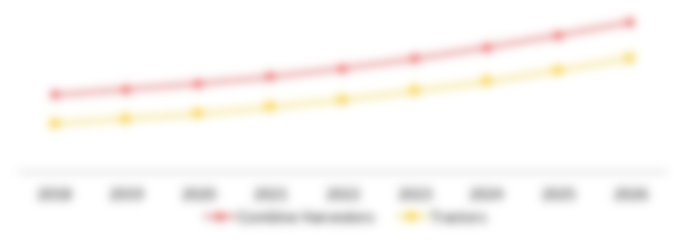
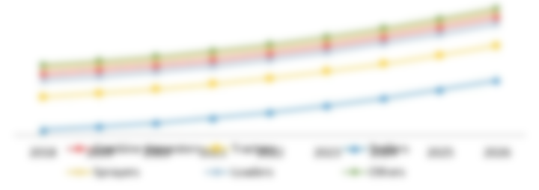
EXECUTIVE SUMMARY
By Type, 2022 & 2030
By Carrier Type, 2022 & 2030

Slide 43
EXECUTIVE SUMMARY
By Depth, 2022 & 2030
By Hull Type, 2022 & 2030

Slide 44
EXECUTIVE SUMMARY
By Region, 2022 & 2030

Slide 45
SECTION 4
Drivers
Restraints
Opportunities
Impact Analysis
MARKET DYNAMICS

Slide 46
MARKET DYNAMICS
MARKET DRIVERS AND RESTRAINTS
DRIVERS
RESTRAINTS
Rise in offshore activities in deep water areas
Flexibility of the system
XX
Severe budget constraints and limited FPSO service to the current production platforms
XX

Slide 47
MARKET DYNAMICS
Rise in offshore activities in deep water areas
In the past many years, operators have been pushing the boundaries of ultra-deepwater exploration, particularly in the Arctic region, in quest of fresh oil and gas assets. According to a U.S. geological analysis, the Arctic region harbors nearly 30% of the world's undiscovered gas and 13% of its unknown oil reserves. These figures demand to invest much money in the Arctic.
U.S. Geological Survey estimates that five provinces—Amerasia Basin, Arctic Alaska, East Greenland Rift Basins, East Barents Basins and West Greenland-East Canada—hold around 70% of undiscovered oil resources, which has massively improved petroleum resource development of the region. The mentioned numbers present a lucrative opportunity for FPSO service providers.
Apart from the arctic, A flurry of offshore activity in Asia-Pacific, particularly in India, leads to strong and long-term contracts for the FPSO business. For instance, in 2021, Egypt plans to explore oil and natural gas at 9 new sites in the Red Sea and the Mediterranean, which will need around US$ 1.4 billion in investment into the country's offshore sector. Moreover, By 2035, offshore oil and natural gas development is expected to produce an incremental 1.3 million barrels of oil equivalent per day and contribute up to US$23.5 billion per year to U.S. economy while generating US$ 51 billion in cumulative government revenue.
Deep-water offshore regions are seeing an increase in exploration due to the depletion of existing onshore oil and gas reserves. Most oil and gas exploration occurs in offshore fields, particularly in the North Sea, Brazil and West Africa. Global investments in new oil and gas fields are being driven by increased demand for oil and gas due to rising fuel consumption. Additionally, it is anticipated that demand for FPSOs would increase throughout the projection period due to upstream oil and gas industry expansion and government incentives to promote offshore oil and gas exploration.
DRIVERS

Slide 48
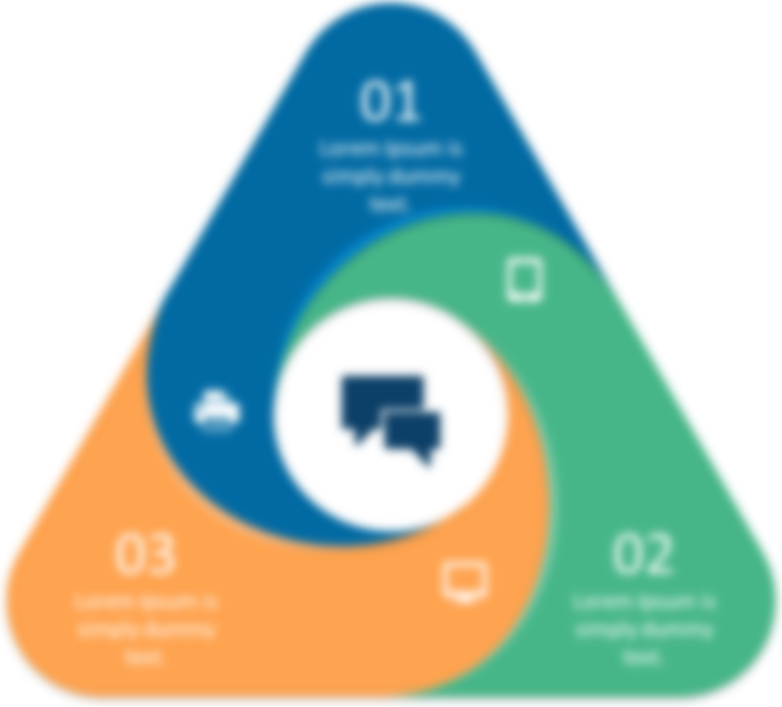
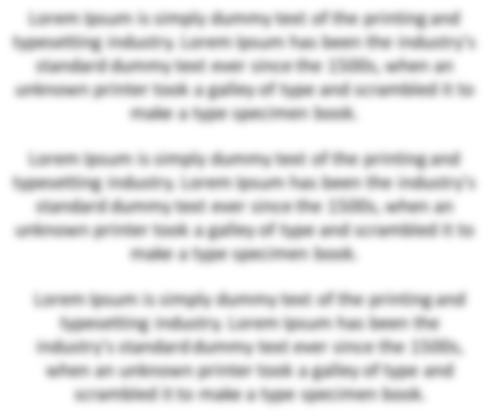
MARKET DYNAMICS - OPPORTUNITIES
01
02
03

Slide 49
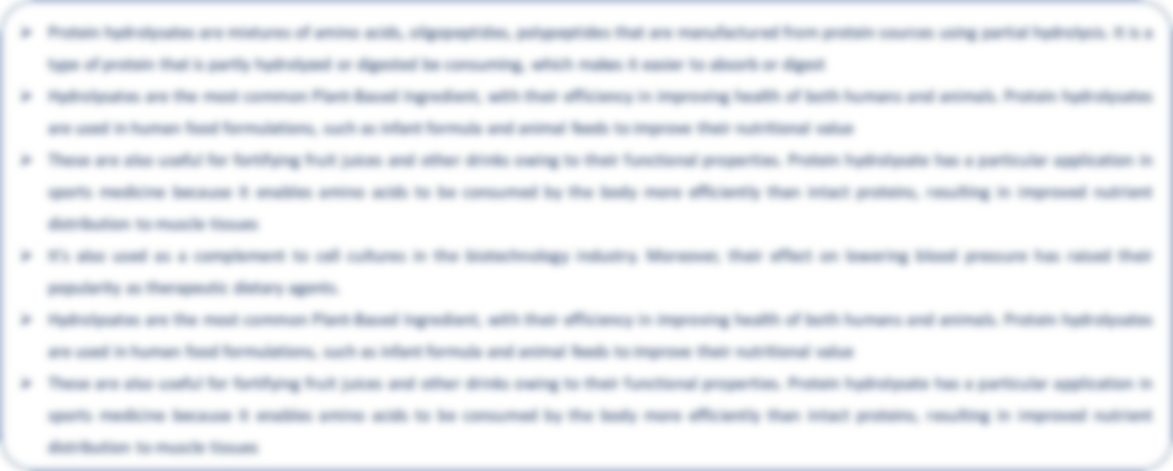
COVID-19 IMPACT ANALYSIS

Slide 50
SECTION 8
Converted Ship
New Build Ship
Redeployed
MARKET SEGMENTATION BY CARRIER TYPE

Slide 51
MARKET SEGMENTATION – BY CARRIER TYPE
Global Floating Production Storage and Offloading (FPSO) Market Value (US$ Million), By Carrier Type, 2022, 2026 & 2030
Global Floating Production Storage and Offloading (FPSO) Market Share (%), By Carrier Type, 2022
Carrier Type | 2022 | 2026 | 2030
Converted Ship | XX | XX | XX
New Build Ship | XX | XX | XX
Redeployed | XX | XX | XX

Slide 52
MARKET SEGMENTATION – BY CARRIER TYPE
Global Floating Production Storage and Offloading (FPSO) Market Value (US$ Million), By Carrier Type, 2021-2030
Carrier Type | 2021 | 2022 | 2023 | 2024 | 2025 | 2026 | 2027 | 2028 | 2029 | 2030 | CAGR (%) 2023-2030
Converted Ship | XX | XX | XX | XX | XX | XX | XX | XX | XX | XX | XX
New Build Ship | XX | XX | XX | XX | XX | XX | XX | XX | XX | XX | XX
Redeployed | XX | XX | XX | XX | XX | XX | XX | XX | XX | XX | XX

Slide 53
MARKET SEGMENTATION – BY CARRIER TYPE
Converted Ship
Global Floating Production Storage and Offloading (FPSO) Market Value (US$ Million), 2021-2030

Slide 54
MARKET SEGMENTATION – BY CARRIER TYPE
Converted Ship
The converted ship in the global floating production storage and offloading (FPSO) market was us$ xx million in 2022 and is expected to reach us$ xx million by 2030, growing with a CAGR of xx% between 2023 and 2030.
A floating production system, an FPSO vessel, is utilized for offshore oil and gas production, storing and unloading. A typical FPSO resembles a ship with onboard production and processing facilities.
A shuttle tanker transports processed oil and gas from FPSOs to onshore receiving facilities through offloading. These ships harvest or unprocessed transport hydrocarbons from the ocean floor, which are then refined onboard.
Typically, it is a newly built FPSO unit or a vessel that has been converted from an oil tanker. The global FPSO market is divided into three types: new build ships, redeployed and converted ships.
The segment of converted FPSO systems now controls the market. On the other hand, the demand for brand-new FPSO systems has declined due to the drop in oil prices in the oil and gas exploration sectors.
It is a frequent practice to convert a transportation vessel into an FPSO to reduce costs, shorten lead times or manage assets. A used tanker may cost several hundred million dollars to buy and convert into a production unit like an FPSO, but a newly built FPSO with the same capacity may cost up to a billion dollars to design, engineer and build. A tanker could be transformed into an FPSO in months, while a brand-new FPSO would require many years from the final investment decision (FID).

Slide 55
SECTION 11
North America
South America
Europe
Asia-Pacific
Middle East & Africa
MARKET SEGMENTATION
BY REGION

Slide 56
MARKET SEGMETATION - BY REGION
Global Floating Production Storage and Offloading (FPSO) Market Value (US$ Million), By Region, 2022, 2026 & 2030
Global Floating Production Storage and Offloading (FPSO) Market Share (%), By Region, 2022
Region | 2022 | 2026 | 2030
North America | XX | XX | XX
South America | XX | XX | XX
Europe | XX | XX | XX
Asia-Pacific | XX | XX | XX
Middle East & Africa | XX | XX | XX

Slide 57
MARKET SEGMETATION - BY REGION
Global Floating Production Storage and Offloading (FPSO) Market Value (US$ Million), By Region, 2021-2030
Region | 2021 | 2022 | 2023 | 2024 | 2025 | 2026 | 2027 | 2028 | 2029 | 2030 | CAGR (%) 2023-2030
North America | XX | XX | XX | XX | XX | XX | XX | XX | XX | XX | XX
South America | XX | XX | XX | XX | XX | XX | XX | XX | XX | XX | XX
Europe | XX | XX | XX | XX | XX | XX | XX | XX | XX | XX | XX
Asia-Pacific | XX | XX | XX | XX | XX | XX | XX | XX | XX | XX | XX
Middle East & Africa | XX | XX | XX | XX | XX | XX | XX | XX | XX | XX | XX

Slide 58
MARKET SEGMETATION - BY REGION
South America Floating Production Storage and Offloading (FPSO) Market Value (US$ Million), 2021-2030

Slide 59
MARKET SEGMENTATION – BY REGION
South America
The South America floating production storage and offloading (FPSO) market was US$ XX Million in 2022 and is expected to reach US$ XX Million by 2030, growing with a CAGR of XX% between 2023 and 2030.
The South American region is anticipated to have the biggest influence on the global FPSO market. Since the need for FPSOs has significantly expanded recently, Brazil and Guyana are the two major nations on the market.
Most FPSO units have been operational in Brazil over the past five years. As of 2020, the Buzios field had the most FPSOs deployed, with a combined production capacity of 600,000 barrels per day. Lease agreements with various third parties mostly caused the fact mentioned above. Petrobras, the only field operator in the country, has begun its bidding process to choose FPSO companies to build additional units for the field.
Rio de Janeiro, where nearly all the producing areas were offshore, had Brazil's greatest crude oil output in 2020, generating around 853 million barrels. Additionally, seven out of ten FPSO contracted projects in 2021 originated from Brazil and three more will be included in the nation's portfolio in 2022.
A joint venture managed by Saipem received an FPSO building contract from Petrobras in June 2021 for developing the offshore Buzios field. Saipem and DSME will create the FPSO with the name P-79 with a daily processing capacity for oil of 180,000 barrels and a daily processing capacity for gas of 7.2 million cubic meters. The unit and other FPSOs for the field are anticipated to start operating before 2027.
Similarly, Petrobras sent two letters of intent to deliver the IPB FPSO under a lease and operate arrangement to Yinson Holdings Berhad on November 15, 2021. The FPSO will be implemented in the Jubarte field in Brazil's North Campos basin. US$ 5.2 billion project is anticipated to begin operations in 2025 and provide the corporation with service for an additional 22.5 years.

Slide 60
MARKET SEGMETATION - BY REGION
South America Floating Production Storage and Offloading (FPSO) Market Value (US$ Million), By Type, 2021-2030
Type | 2021 | 2022 | 2023 | 2024 | 2025 | 2026 | 2027 | 2028 | 2029 | 2030 | CAGR (%) 2023-2030
Oil | XX | XX | XX | XX | XX | XX | XX | XX | XX | XX | XX
LPG | XX | XX | XX | XX | XX | XX | XX | XX | XX | XX | XX
LNG | XX | XX | XX | XX | XX | XX | XX | XX | XX | XX | XX
Others | XX | XX | XX | XX | XX | XX | XX | XX | XX | XX | XX

Slide 61
MARKET SEGMETATION - BY REGION
South America Floating Production Storage and Offloading (FPSO) Market Value (US$ Million), By Carrier Type, 2021-2030
Carrier Type | 2021 | 2022 | 2023 | 2024 | 2025 | 2026 | 2027 | 2028 | 2029 | 2030 | CAGR (%) 2023-2030
Converted Ship | XX | XX | XX | XX | XX | XX | XX | XX | XX | XX | XX
New Build Ship | XX | XX | XX | XX | XX | XX | XX | XX | XX | XX | XX
Redeployed | XX | XX | XX | XX | XX | XX | XX | XX | XX | XX | XX

Slide 62
MARKET SEGMETATION - BY REGION
South America Floating Production Storage and Offloading (FPSO) Market Value (US$ Million), By Water Depth, 2021-2030
Water Depth | 2021 | 2022 | 2023 | 2024 | 2025 | 2026 | 2027 | 2028 | 2029 | 2030 | CAGR (%) 2023-2030
Shallow Water | XX | XX | XX | XX | XX | XX | XX | XX | XX | XX | XX
Deep & Ultra-deep Water | XX | XX | XX | XX | XX | XX | XX | XX | XX | XX | XX

Slide 63
MARKET SEGMETATION - BY REGION
South America Floating Production Storage and Offloading (FPSO) Market Value (US$ Million), By Hull Type, 2021-2030
Hull Type | 2021 | 2022 | 2023 | 2024 | 2025 | 2026 | 2027 | 2028 | 2029 | 2030 | CAGR (%) 2023-2030
Single Hull | XX | XX | XX | XX | XX | XX | XX | XX | XX | XX | XX
Double Hull | XX | XX | XX | XX | XX | XX | XX | XX | XX | XX | XX

Slide 64
MARKET SEGMETATION - BY REGION
South America Floating Production Storage and Offloading (FPSO) Market Value (US$ Million), By Country, 2021-2030
Country | 2021 | 2022 | 2023 | 2024 | 2025 | 2026 | 2027 | 2028 | 2029 | 2030 | CAGR (%) 2023-2030
Brazil | XX | XX | XX | XX | XX | XX | XX | XX | XX | XX | XX
Argentina | XX | XX | XX | XX | XX | XX | XX | XX | XX | XX | XX
Rest of South America | XX | XX | XX | XX | XX | XX | XX | XX | XX | XX | XX

Slide 65
SECTION 12
Competitive Scenario
Market Positioning/Share Analysis
Mergers and Acquisitions Analysis
COMPETITIVE LANDSCAPE

Slide 66
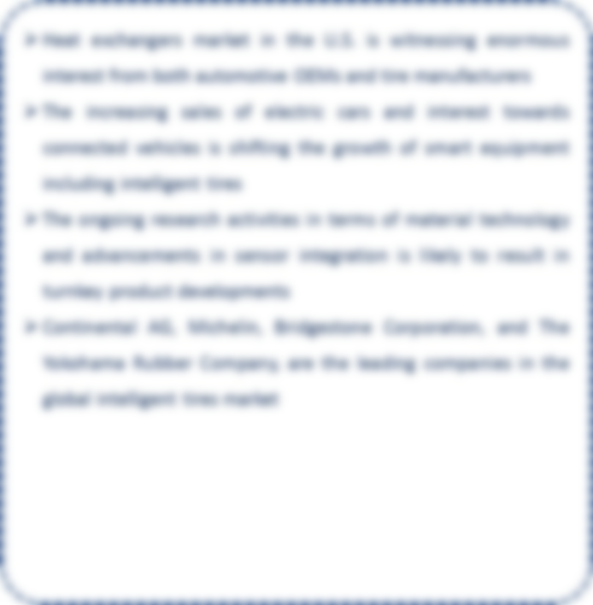
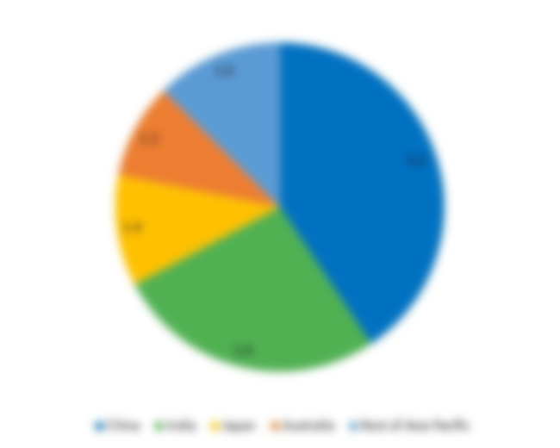
MARKET SHARE ANALYSIS - OVERVIEW

Slide 67
BP Plc
Aker Solutions ASA
Bluewater Energy Services B.V.
Bumi Armada Berhad
BW Offshore
Chevron
ExxonMobil
MODEC
Petrobras
Petronas
SBM Offshore
Shell
Teekay Corporation
Yinson Holdings Berhad
SECTION 13
COMPANY PROFILES

Slide 68

EXXON MOBIL CORPORATION – OVERVIEW
OVERVIEW
Exxon Mobil Corporation supplies its products through three (3) product categories: upstream, downstream and chemical. The company supply acoustic insulation products through its "chemicals" segment
The company operates in around twenty – one (21) countries globally in all the four major regions North America, South America, Europe and Asia–Pacific and the company has more than 160 nationalities represented in our employee base
The company has made six (6) major deep – water discoveries with eight (8) agreements to research lower – emission technologies. The company has thirteen (13) chemical growth projects with three (3) new facilities operating above design rates. The company has more than 20,000 scientists and engineers, including 2,300 PhDs
Exxon Mobil Corporation
Year of Estd. | 1999
Headquarters | Texas, U.S.
Company Type | Public
No. of Employees (2021) | ~74,900
Website | www.corporate.exxonmobil.com

Slide 69
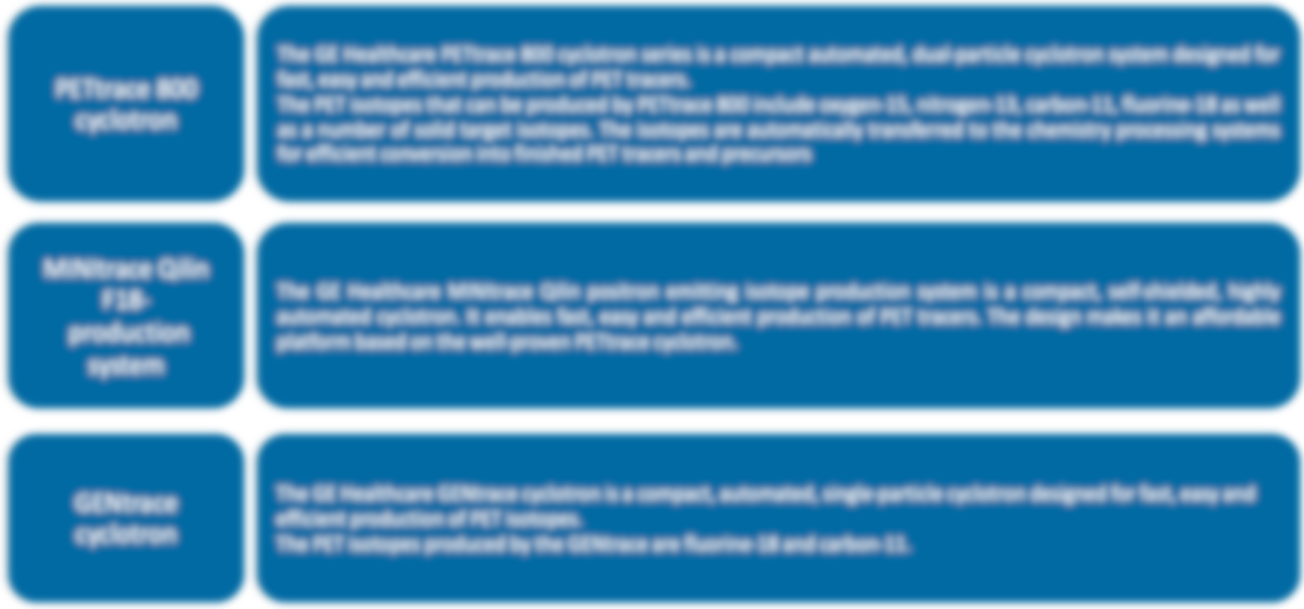
EXXON MOBIL CORPORATION – PRODUCTS

Slide 70
EXXON MOBIL CORPORATION – FINANCIALS

Slide 71
EXXON MOBIL CORPORATION – FINANCIALS

Slide 72


EXXON MOBIL CORPORATION – KEY DEVELOPMENTS
March 30, 2023
Partnership

Slide 73
SECTION 14
APPENDIX

Slide 74
ABOUT US
DataM Intelligence 4Market Research is a market intelligence platform which gives access to syndicated, customised reports and consulting to its clients at one place. As a firm with rich experience in research and consulting across multiple domains we are one stop solution that will cater to the needs of clients in key business areas. DataM Intelligence has an online platform whose coverage includes industries such as Chemicals and Materials, Agriculture, Health care services, Animal feed and food & beverages, among others. Our platform has Insights on markets that uncover latest market research data that’s distinct from the competition. With coverage across 10 major industries in the marketplace research, DataM Intelligence benefits thousands of companies by helping them take their innovations early to the market by providing a complete view of the market with statistical forecasts. Our strategy centric framework and value-added services will let individuals and corporates with ease of access and custom personalization to research and markets.

